Slide 1


On the Computational Complexity of Minimal Cumulative Cost Graph Pebbling
Graph Pebbling is Cool and Important!...but Hard
Jeremiah Blocki
Samson Zhou

Slide 2
Structure of Talk
Background
Graph Pebbling
“Graph Reducibility”
Open Problems

Slide 3
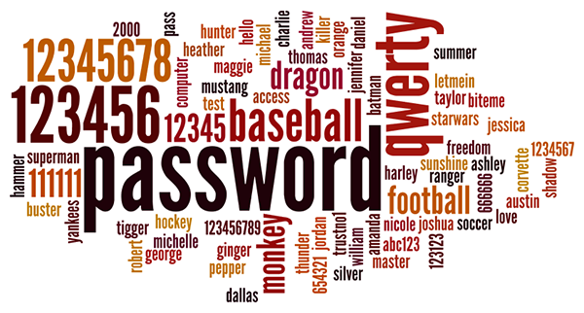
Background
Users tend to pick weak passwords

Slide 4
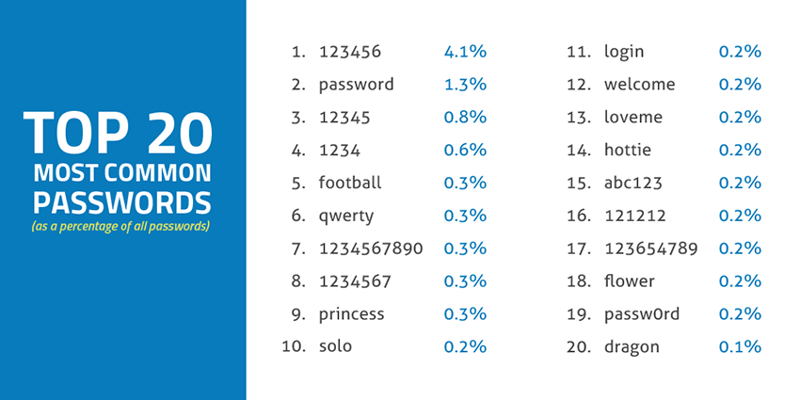
Source: SkyHigh

Slide 5

Background
Users tend to pick weak passwords
Server attacks are inevitable

Slide 6
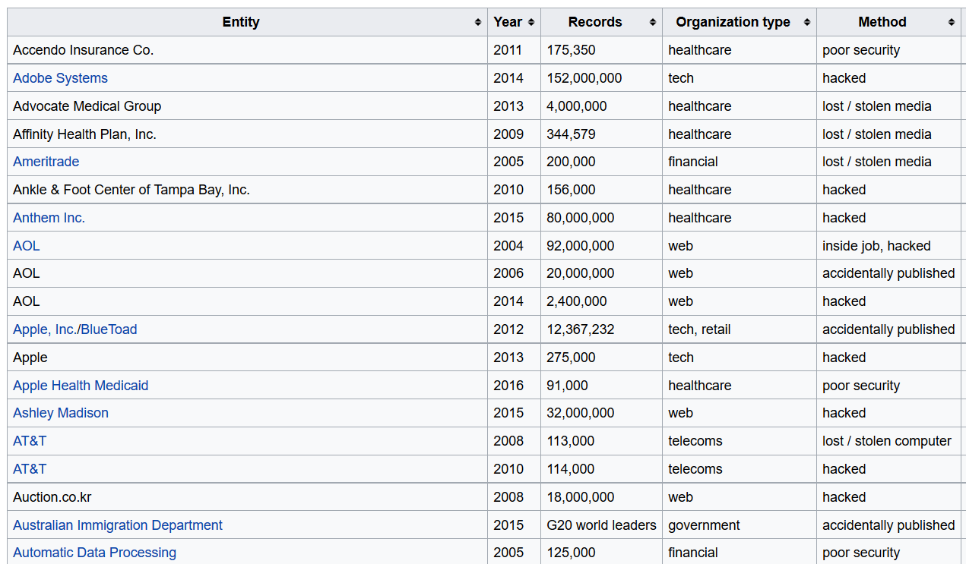

Slide 7
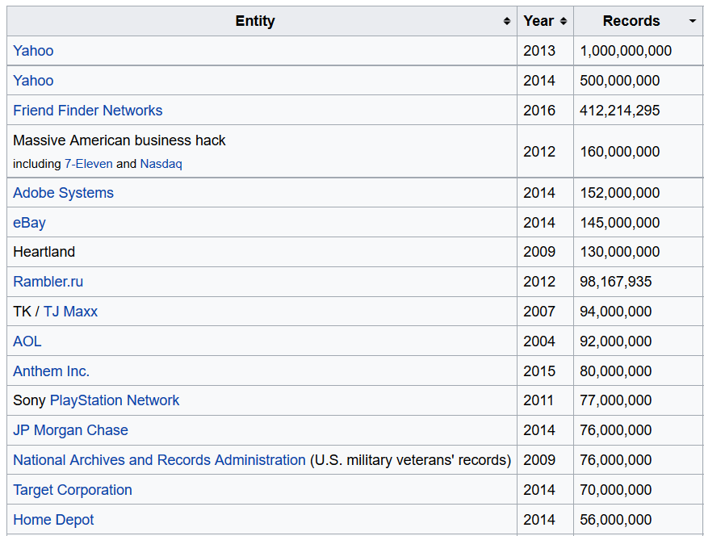

Slide 8















Slide 9





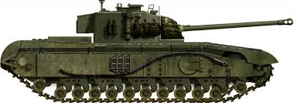

Slide 10
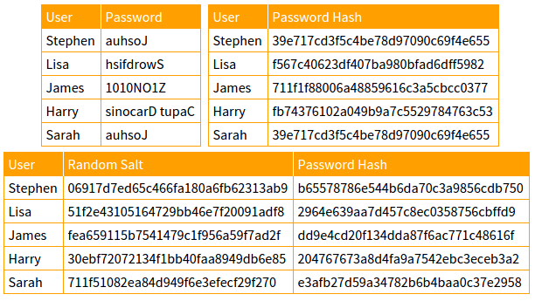

Slide 11
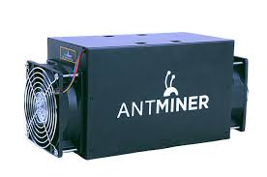
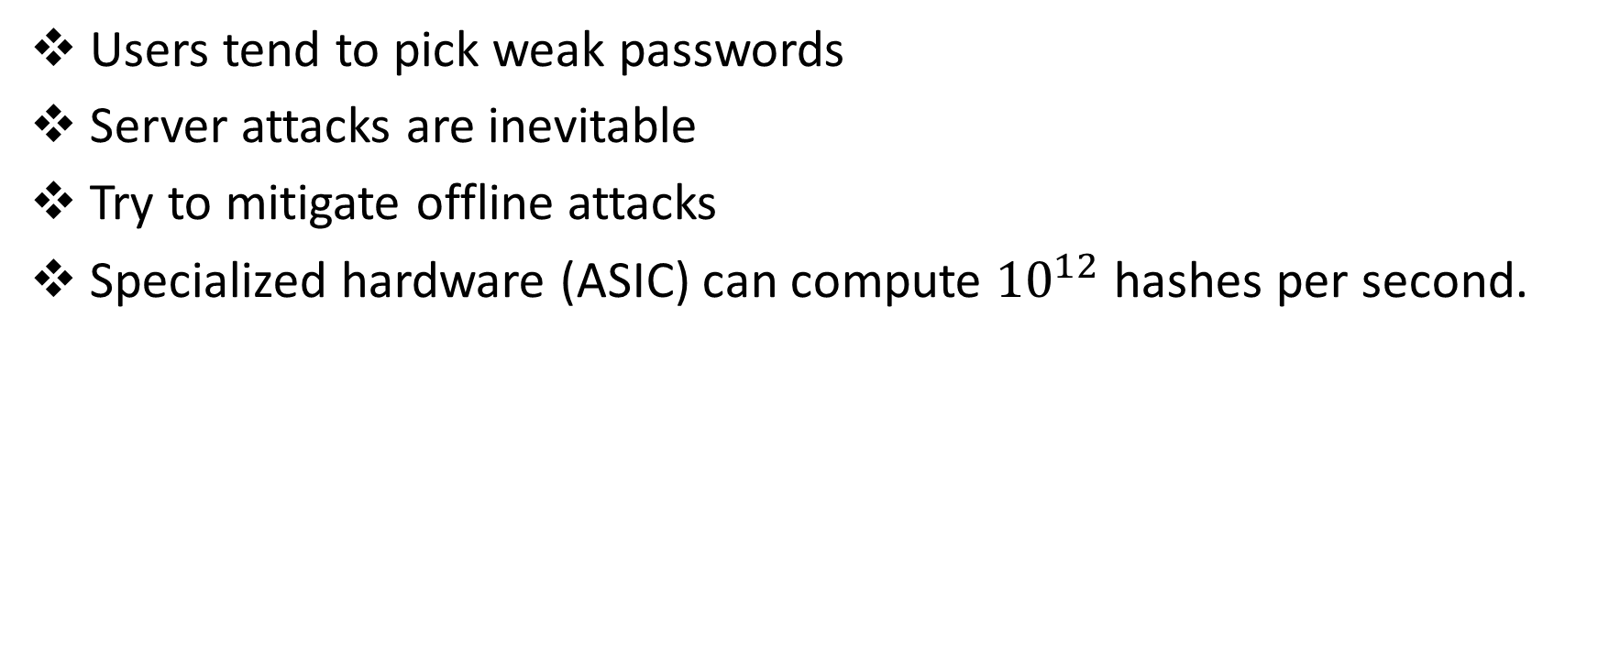
Background
Users tend to pick weak passwords
Server attacks are inevitable
Try to mitigate offline attacks
Specialized hardware (ASIC) can compute ${10}^{12}$ hashes per second.

Slide 12

Hash Function Goals
“Moderately Expensive” to compute
Expensive to compute on ASIC
Fast and cheap on PC

Slide 13
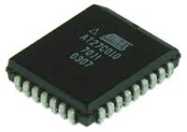
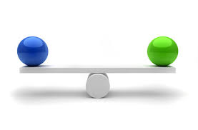


Slide 14
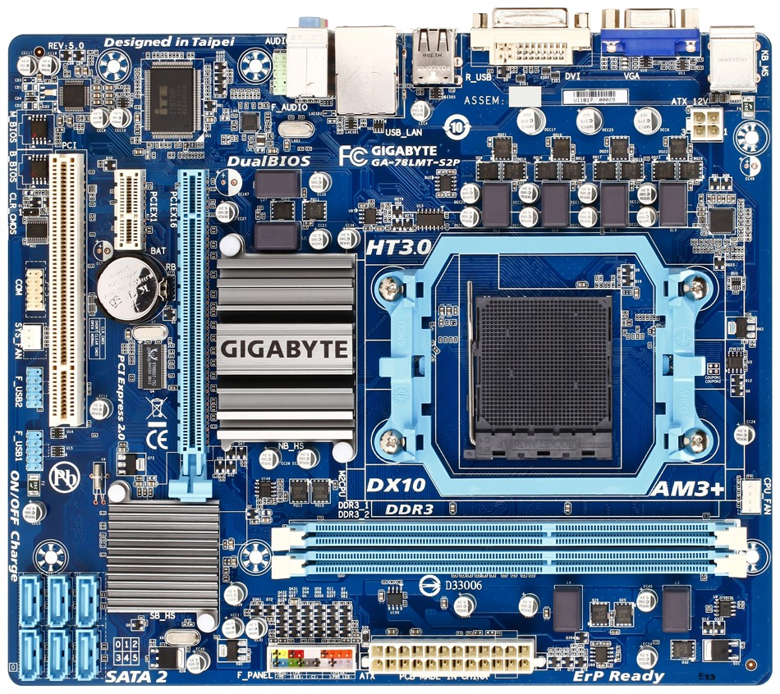
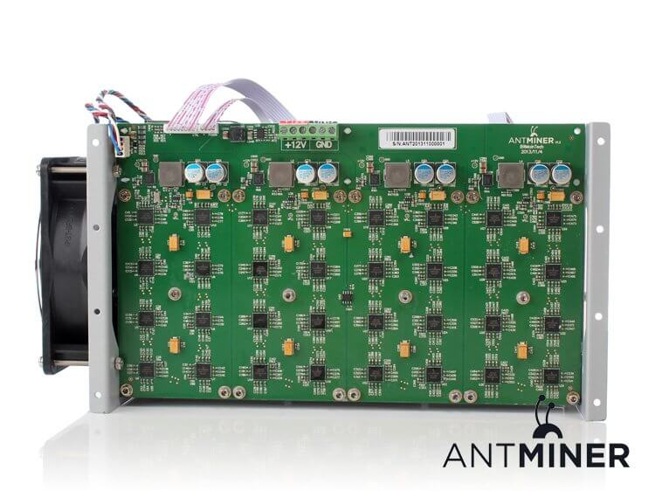

Slide 15
iMHFs
Data-independent memory hard functions require comparatively more resources for adversaries to compute

Slide 16
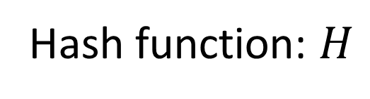
iMHFs
Hash function: $H$

Slide 17
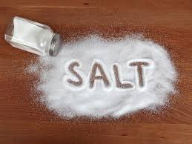
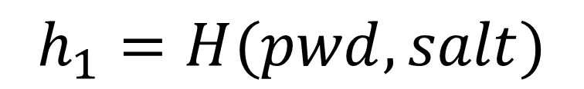
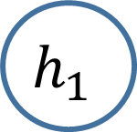
iMHFs
pwd
$$h_{1}$$
$$h_{1}=H(pwd, salt)$$

Slide 18
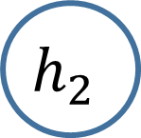

iMHFs
pwd
$$h_{1}$$
$$h_{2}$$
$$h_{2}=H(h_{1})$$

Slide 19
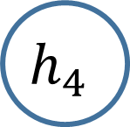
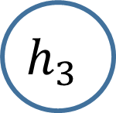
iMHFs
pwd
$$h_{1}$$
$$h_{2}$$
$$h_{3}$$
$$h_{4}$$
$$h_{3}=H\left(h_{1},h_{2}\right), { h}_{4}=H(h_{2})$$

Slide 20

iMHFs
pwd
$$h_{1}$$
$$h_{2}$$
$$h_{3}$$
$$h_{5}$$
$$h_{4}$$
$$h_{5}=H\left(h_{3},h_{4}\right)$$

Slide 21
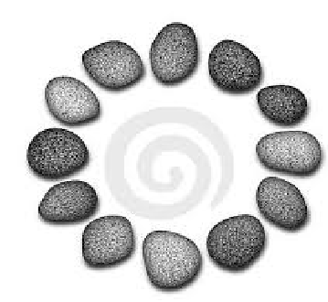
iMHFs
Data-independent memory hard functions require comparatively more resources for adversaries to compute
Calculating an iMHF can be modeled as graph pebbling

Slide 22
Graph Pebbling

Slide 23
Graph Pebbling

Slide 24
Graph Pebbling

Slide 25
Graph Pebbling

Slide 26
Graph Pebbling

Slide 27
Graph Pebbling

Slide 28
Graph Pebbling

Slide 29
Graph Pebbling

Slide 30
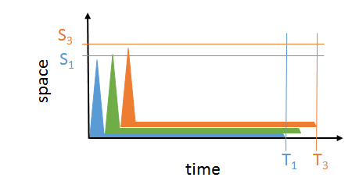
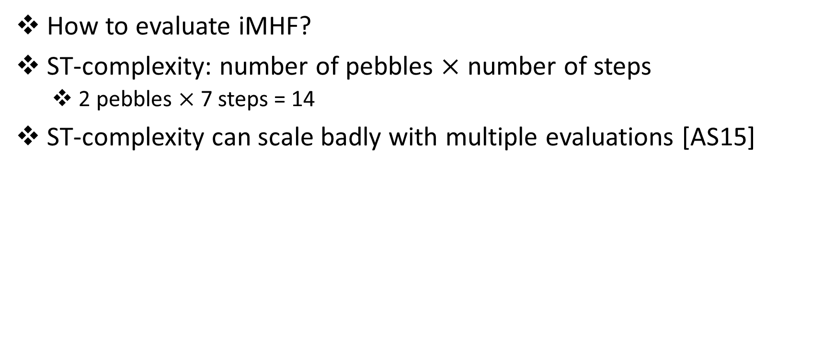
iMHFs
How to evaluate iMHF?
ST-complexity: number of pebbles $×$ number of steps
2 pebbles $×$ 7 steps = 14
ST-complexity can scale badly with multiple evaluations [AS15]

Slide 31



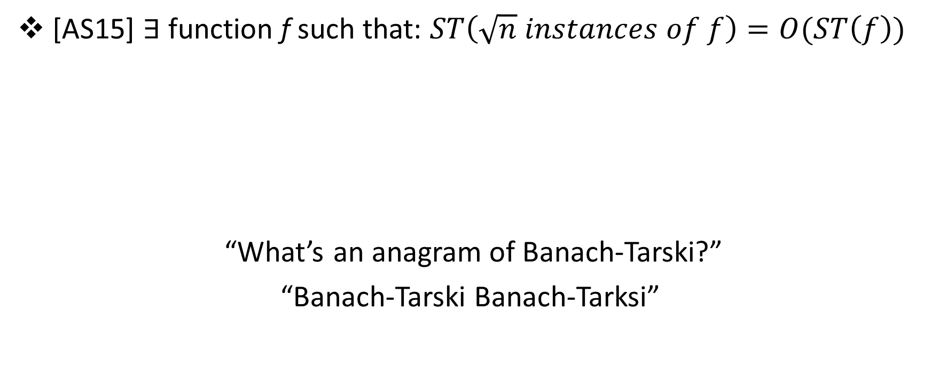
iMHFs
[AS15] $∃$function f such that: $ST\left(\sqrt{n} instances of f\right)=O(ST\left(f\right))$
“What’s an anagram of Banach-Tarski?”
“Banach-Tarski Banach-Tarksi”

Slide 32
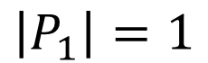
Graph Pebbling
$$\left|P_{1}\right|=1$$

Slide 33
Graph Pebbling
$$\left|P_{1}\right|+\left|P_{2}\right|=1+2=3$$

Slide 34
Graph Pebbling
$$\left|P_{1}\right|+\left|P_{2}\right|+\left|P_{3}\right|=3+2=5$$

Slide 35
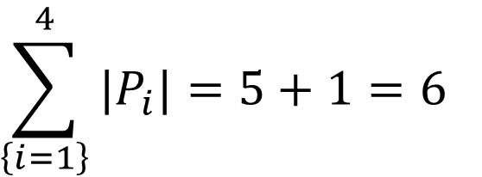
Graph Pebbling
$$\sum_{\left\{i=1\right\}}^{4}{|P_{i}|}=5+1=6$$

Slide 36
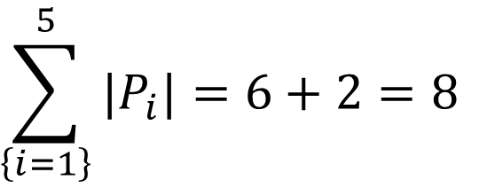
Graph Pebbling
$$\sum_{\left\{i=1\right\}}^{5}{|P_{i}|}=6+2=8$$

Slide 37
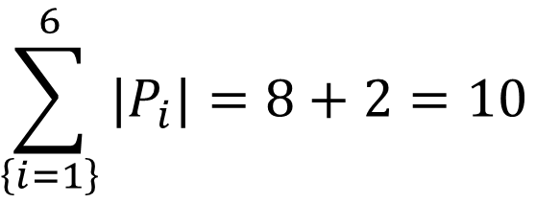
Graph Pebbling
$$\sum_{\left\{i=1\right\}}^{6}{|P_{i}|}=8+2=10$$

Slide 38
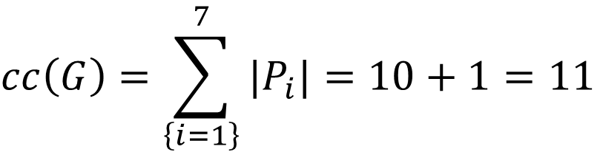
Graph Pebbling
$$cc\left(G\right)=\sum_{\left\{i=1\right\}}^{7}{|P_{i}|}=10+1=11$$

Slide 39
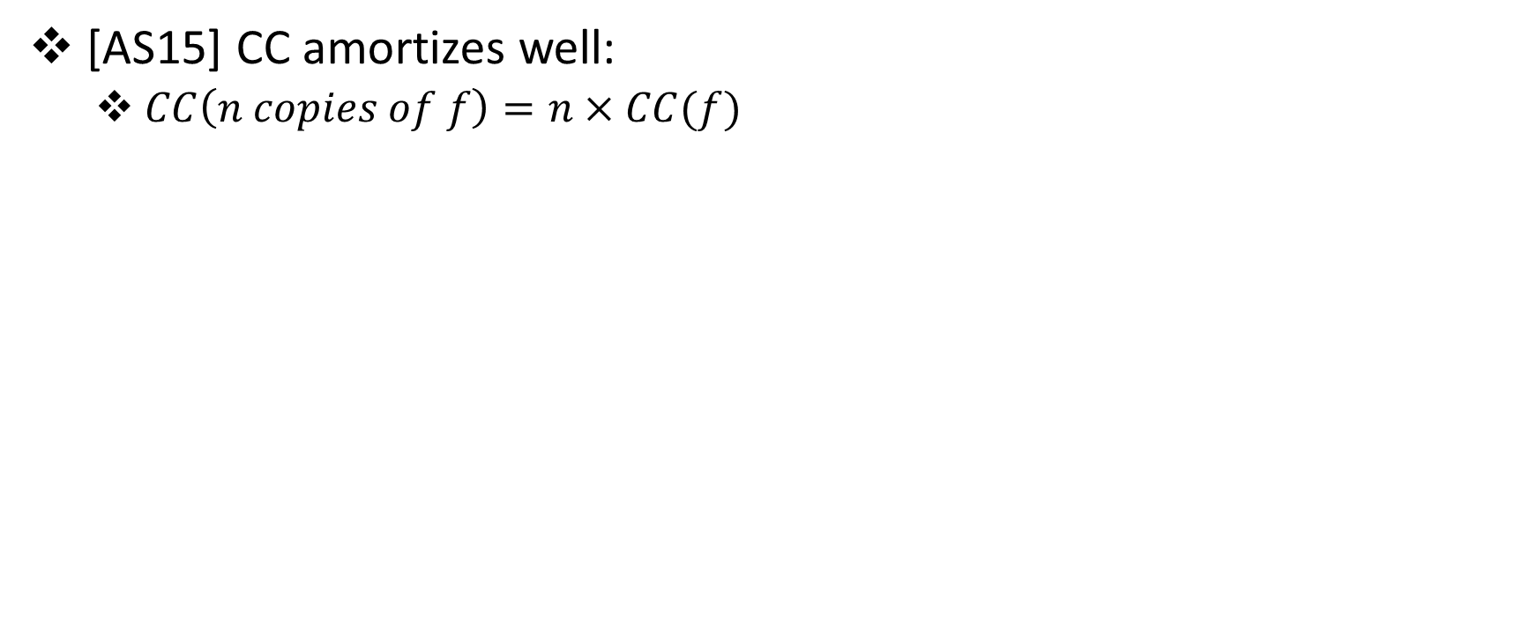
iMHFs
[AS15] CC amortizes well:
$CC\left(n copies of f\right)=n×CC(f)$

Slide 40
iMHFs
Data-independent memory hard functions require comparatively more resources for adversaries to compute
Calculating an iMHF can be modeled as graph pebbling
Cumulative complexity better model than space-time complexity

Slide 41
Structure of Talk
Background
Graph Pebbling
“Graph Reducibility”
Open Problems

Slide 42
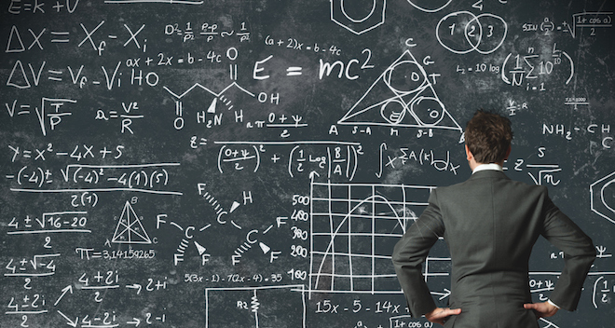
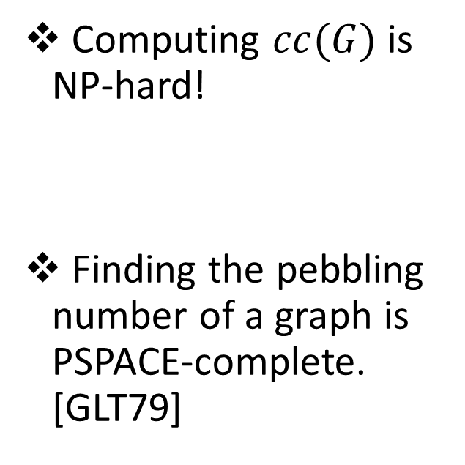
Main Result
Computing $cc(G)$ is NP-hard!
Finding the pebbling number of a graph is PSPACE-complete. [GLT79]

Slide 43
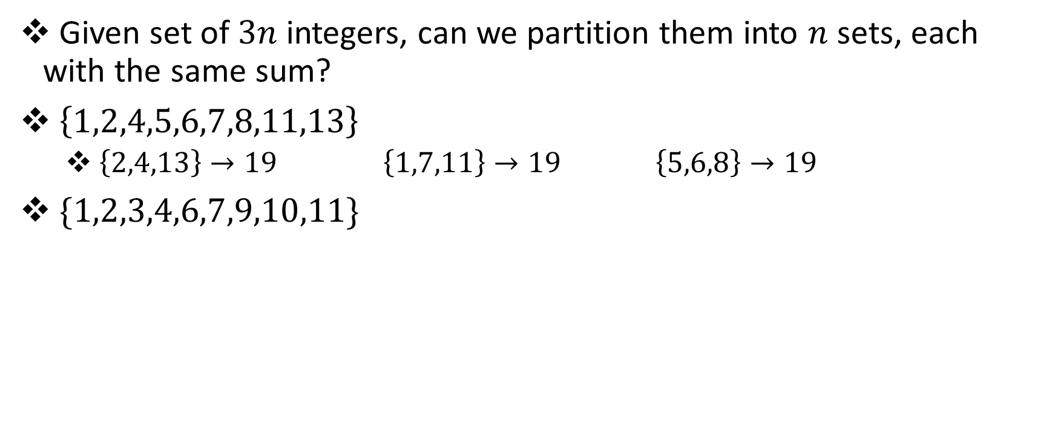
3-PARTITION
Given set of $3n$ integers, can we partition them into $n$ sets, each with the same sum?
$\left\{1,2,4,5,6,7,8,11,13\right\}$
$\left\{2,4,13\right\}→19$ $\left\{1,7,11\right\}→19$ $\left\{5,6,8\right\}→19$
$\{1,2,3,4,6,7,9,10,11\}$

Slide 44
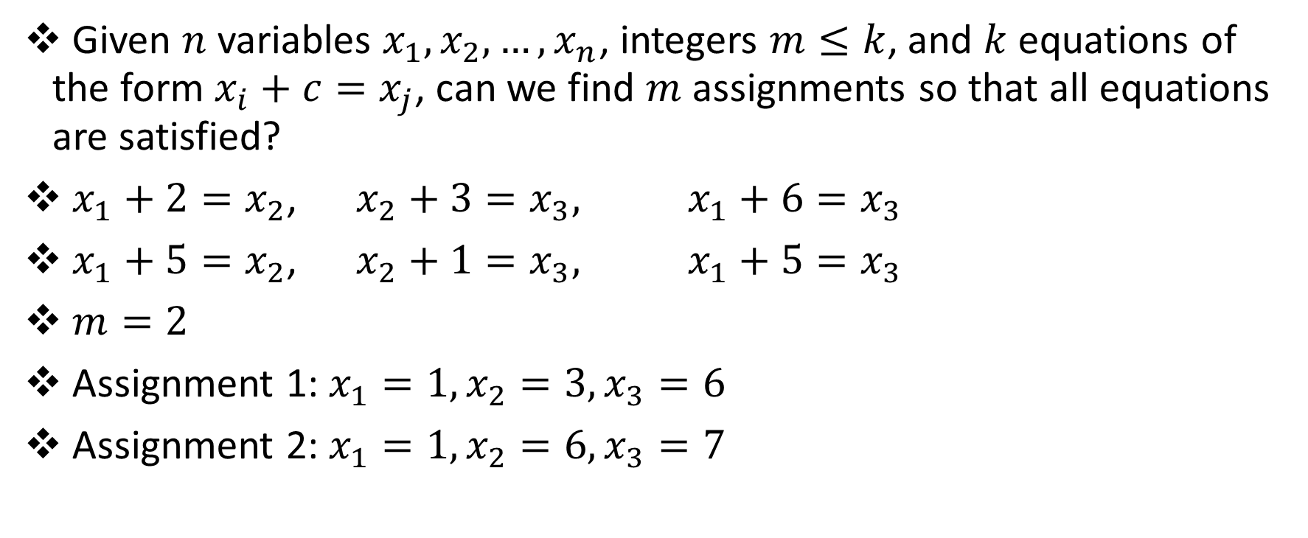
Bounded 2-Linear Covering
Given $n$ variables $x_{1},x_{2},…,x_{n}$, integers $m≤k$, and $k$ equations of the form $x_{i}+c=x_{j}$, can we find $m$ assignments so that all equations are satisfied?
$x_{1}+2=x_{2}$, $x_{2}+3=x_{3},$ $x_{1}+6=x_{3}$
$x_{1}+5=x_{2}$, $x_{2}+1=x_{3},$ $x_{1}+5=x_{3}$
$m=2$
Assignment 1: $x_{1}=1,x_{2}=3,x_{3}=6$
Assignment 2: $x_{1}=1,x_{2}=6,x_{3}=7$

Slide 45
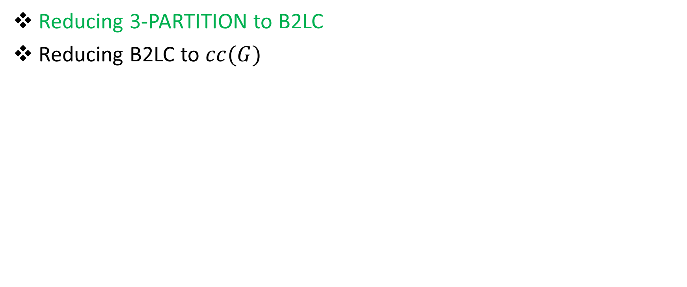
Reductions
Reducing 3-PARTITION to B2LC
Reducing B2LC to $cc(G)$

Slide 46
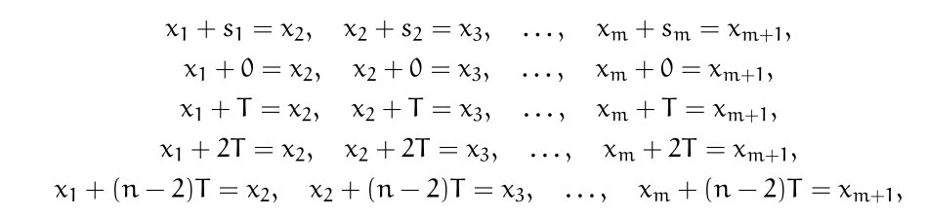
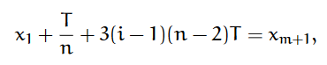
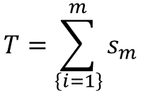
Reductions
$$T=\sum_{\left\{i=1\right\}}^{m}{s_{m}}$$

Slide 47
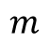
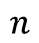
Reductions
$$m$$
$$n$$
$m=3n$ integers in original 3-PARTITION instance

Slide 48
Reductions
$$m$$
$$n$$
$m=3n$ integers in original 3-PARTITION instance

Slide 49
Reductions
$$m$$
$$n$$
$m=3n$ integers in original 3-PARTITION instance

Slide 50
Reductions
$$m$$
$$n$$
$m=3n$ integers in original 3-PARTITION instance

Slide 51
Reductions
$$m$$
$$n$$
$m=3n$ integers in original 3-PARTITION instance

Slide 52
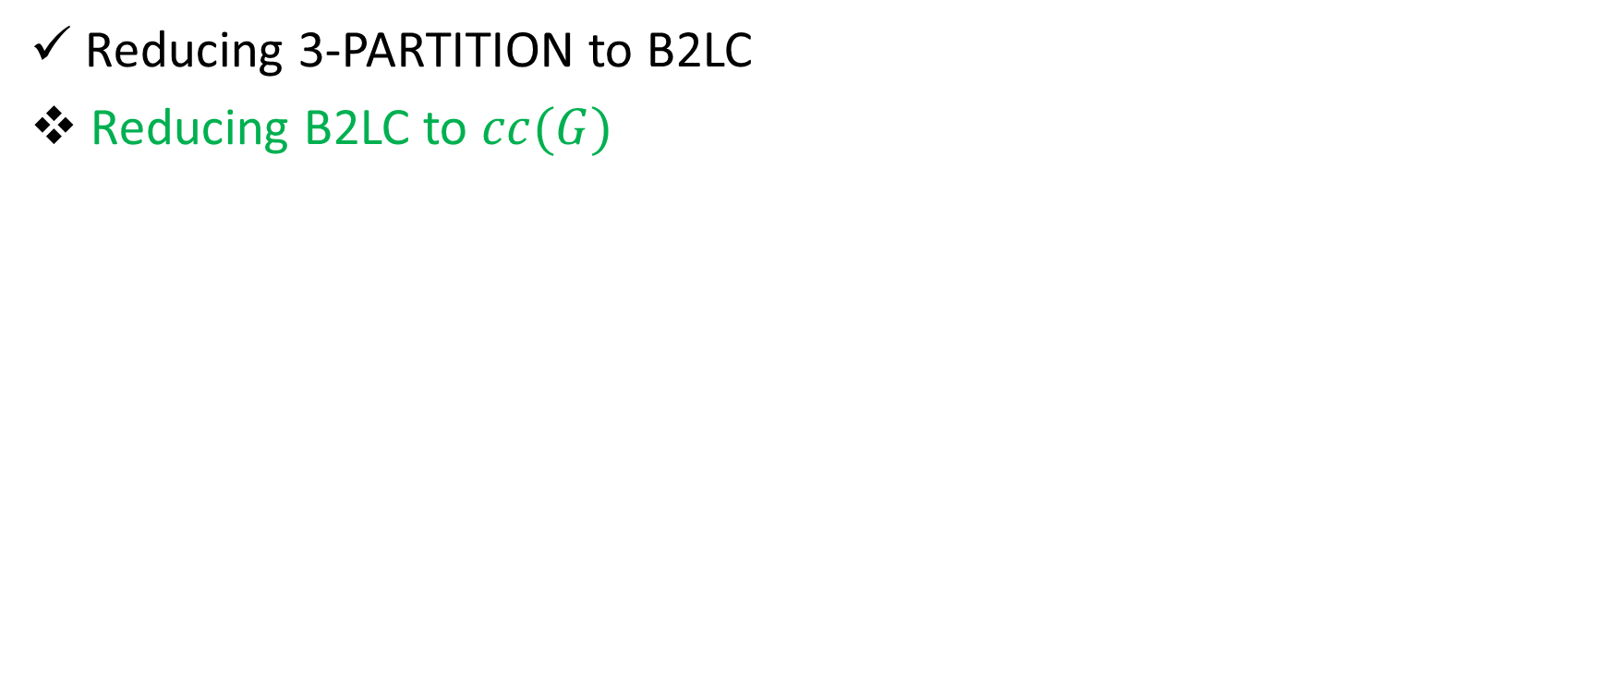
Reductions
Reducing 3-PARTITION to B2LC
Reducing B2LC to $cc(G)$

Slide 53

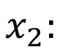
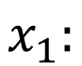
Reductions
$$x_{2}:$$
$$x_{1}:$$

Slide 54
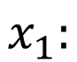
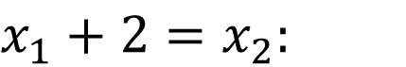
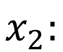
Reductions
$$x_{1}+2=x_{2}:$$
$$x_{2}:$$
$$x_{1}:$$

Slide 55
Honest Pebbling
$$x_{1}+2=x_{2}:$$
$$x_{2}:$$
$$x_{1}:$$

Slide 56
Honest Pebbling
$$x_{1}+2=x_{2}:$$
$$x_{2}:$$
$$x_{1}:$$

Slide 57
Honest Pebbling
$$x_{1}+2=x_{2}:$$
$$x_{2}:$$
$$x_{1}:$$

Slide 58
Honest Pebbling
$$x_{1}+2=x_{2}:$$
$$x_{2}:$$
$$x_{1}:$$

Slide 59
Honest Pebbling
$$x_{1}+2=x_{2}:$$
$$x_{2}:$$
$$x_{1}:$$

Slide 60
Honest Pebbling
$$x_{1}+2=x_{2}:$$
$$x_{2}:$$
$$x_{1}:$$

Slide 61
Honest Pebbling
$$x_{1}+2=x_{2}:$$
$$x_{2}:$$
$$x_{1}:$$

Slide 62
Cheater!
$$x_{1}+2=x_{2}:$$
$$x_{2}:$$
$$x_{1}:$$

Slide 63
Cheater!
$$x_{1}+2=x_{2}:$$
$$x_{2}:$$
$$x_{1}:$$

Slide 64
Cheater!
$$x_{1}+2=x_{2}:$$
$$x_{2}:$$
$$x_{1}:$$

Slide 65
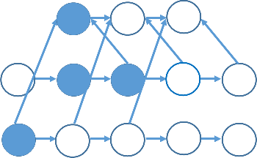
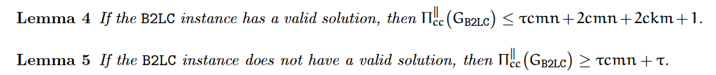
Cheater!

Slide 66
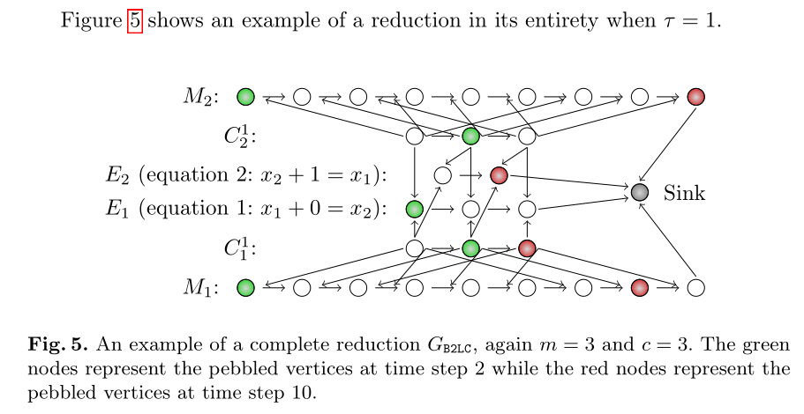
Reductions

Slide 67
Structure of Talk
Background
Graph Pebbling
“Graph Reducibility”
Open Problems

Slide 68
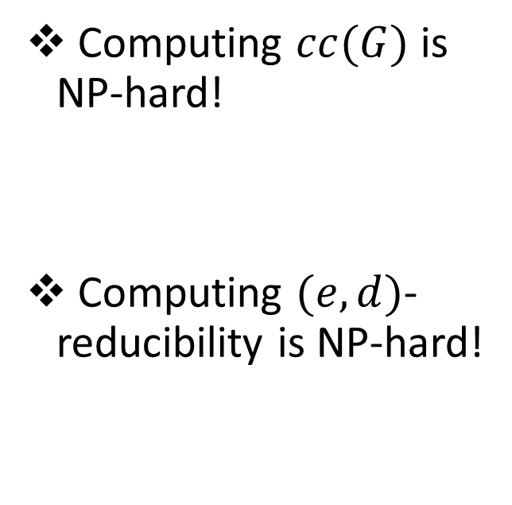
Results
Computing $cc(G)$ is NP-hard!
Computing $(e,d)$- reducibility is NP-hard!

Slide 69
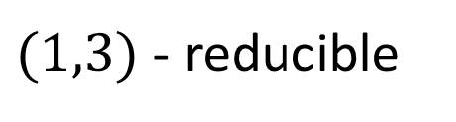

Graph Reducibility
We say that a directed acyclic graph $G$ is $(e,d)$-reducible if there exists a set $S$ of $e$ nodes such that $G−S$ has depth at most $d$.
1
2
3
4
5
6
7
$(1,3)$ - reducible

Slide 70

Graph Reducibility
Can deduce $cc(G)$ from $(e,d)$-reducible!
Depth-robustness is a necessary condition for secure iMHFs (AB16)
There exists attack with $E_{R}\left(A\right)=O\left(en+\sqrt{n^{3}d}\right)$, which is $o(n^{2})$ for $e,d=o(n)$.
Depth-robustness is a sufficient condition for secure iMHFs (ABP16)
$cc\left(G\right)≤ed$

Slide 71

Vertex Cover
Given a graph $G(V,E)$ and an integer $k$, does there exist a subset of $V$ of size $k$ which intersects all edges of $E$?

Slide 72
Vertex Cover
Given a graph $G(V,E)$ and an integer $k$, does there exist a subset of $V$ of size $k$ which intersects all edges of $E$?

Slide 73
Vertex Cover
Given a graph $G(V,E)$ and an integer $k$, does there exist a subset of $V$ of size $k$ which intersects all edges of $E$?

Slide 74
Vertex Cover
Given a graph $G(V,E)$ and an integer $k$, does there exist a subset of $V$ of size $k$ which intersects all edges of $E$?

Slide 75

Reduction
Arbitrarily label the vertices $1,2,…,n$, and direct edges in topological ordering.

Slide 76
Reduction
Arbitrarily label the vertices $1,2,…,n$, and direct edges in topological ordering.
1
2
4
5
3

Slide 77
Reduction
Arbitrarily label the vertices $1,2,…,n$, and direct edges in topological ordering.
1
2
4
5
3

Slide 78

Reduction
For vertex $i$, create an ingoing path of length $i−1$ and an outgoing path of length $n−i$.
1
2
4
5
3

Slide 79

Reduction
4
3
1
3
1
2
4
5
1
3
Path of length $n$ if and only if a blue edge remains!
2
4
2

Slide 80



Slide 81

Summary
We show computing $cc(G)$ is NP-hard (as is computing $st(G)$).
Linear Program for $cc(G)$ has $Ω\left(\frac{n}{\log{n}}\right)$ integrality gap.
We show that given $e,d$, it is NP-hard to determine whether a graph is $(e,d)$-reducible (even for graphs with bounded degree).
Given $d$, it is hard to:
Approximate $e$ to a factor of 1.3 (minimum Vertex Cover).
Approximate $e$ to a factor of 2 (Unique Games Conjecture).
An optimal cumulative cost pebbling of a graph may take more than $n$ steps.

Slide 82
Structure of Talk
Background
Graph Pebbling
“Graph Reducibility”
Open Problems

Slide 83


Open Questions
Does there exist an algorithm to approximate $cc(G)$?
Do there exist constants $c_{1}$, $c_{2}$ so that given an $(e,d)$-reducible graph, we can a set $S$ of $c_{1}e$ nodes such that $G−S$ has depth at most $c_{2}d$?
Does there exist a graph with $cc\left(G\right)=\frac{n^{2}}{\log{n}}$ and space 3? (ADNV17)
1
2
3
4
5
6
7
$(1,3)$ - reducible

Slide 84


Slide 85

Questions?

